Slide 1
Final Exam
Brandon Parmanand
sta5736
Notes:
Final Exam Presentation

Slide 2
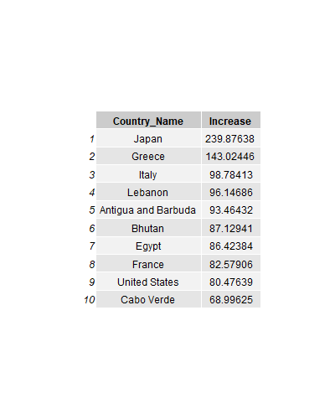
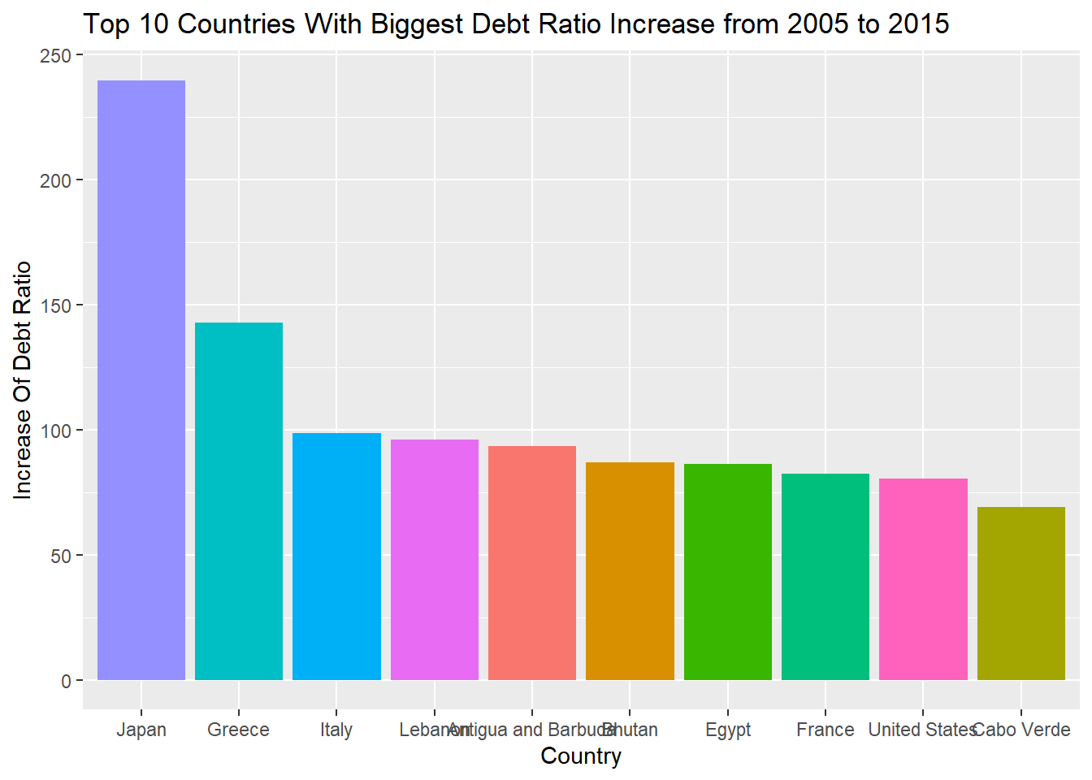
Countries W/ Highest Debt Ratio Increase from 2005 to 2015
Question 1
Notes:
For number 1, I transformed the data using the pivot_longer function while also removing Nas. I created a subset for 2015 and for 2005 and then calculated the increase of each countryies debt ratio over that period to get Japan, Greece and Italy as the top 3. You can see Japan is very high at 240.

Slide 3
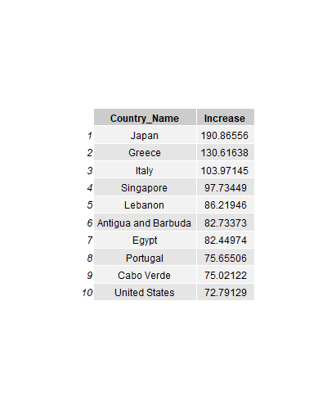
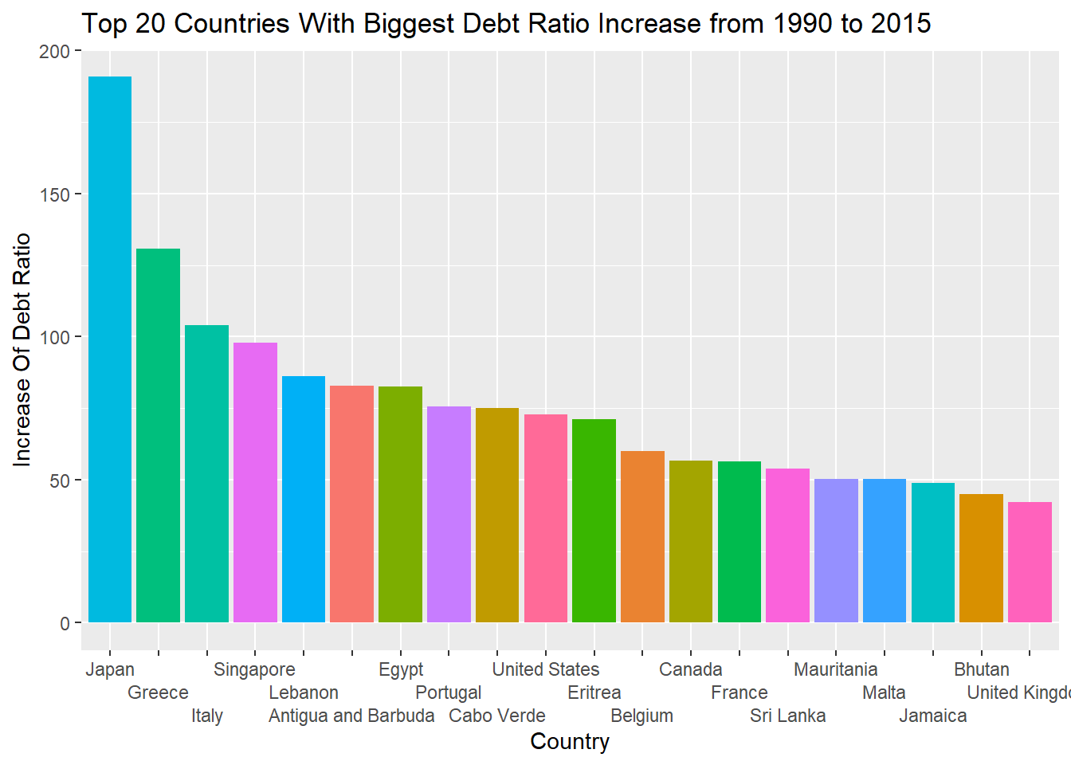
Top 20 Countries W/ Highest Debt Ratio Increase from 1990 to 2015
Notes:
Here I depict the same increase from 1990 to 2015 and we can see that the same countiries have had a massive increase since 1990.

Slide 4
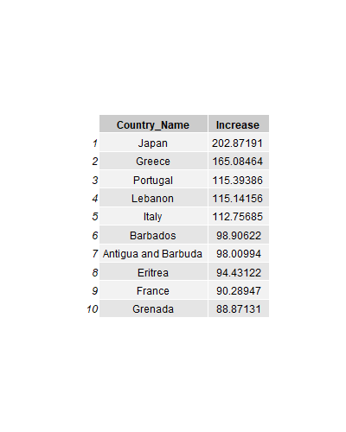
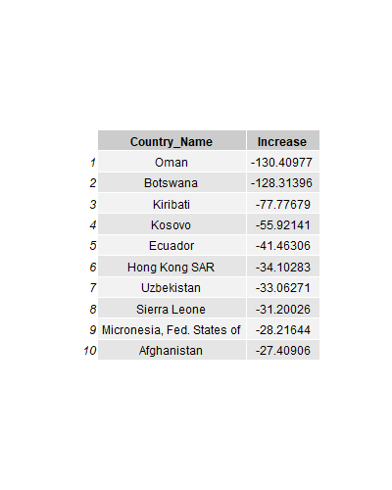
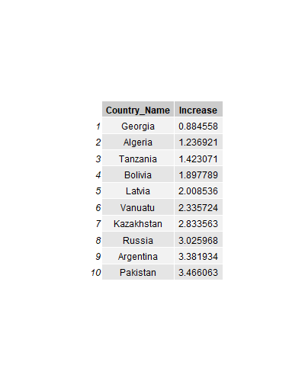
Most Volatile Increase
Analyzing Most Volatile and Most Stable Countries from 1973
Most Stable
Most Volatile Decrease
Notes:
In order to analyze the most volatile, my metric composed of seeing what countries had the largest decrease from in their debt ratio and also what countries had the largest increase. I also wanted to use data for all countries possible and the earliest data point of 1800 only had 4 countries with data. So therefore I chose to to analyze from 1973 to 2015 as 973 was the first year with at least 100 countries observations. We see Japan and Greece still top the chart for that time period and Oman and Botswana have had the sharpest decrease. On the other hand, we have here the countries with the most stable Debt Ratio over the years such as Georgia and Algeria.

Slide 5
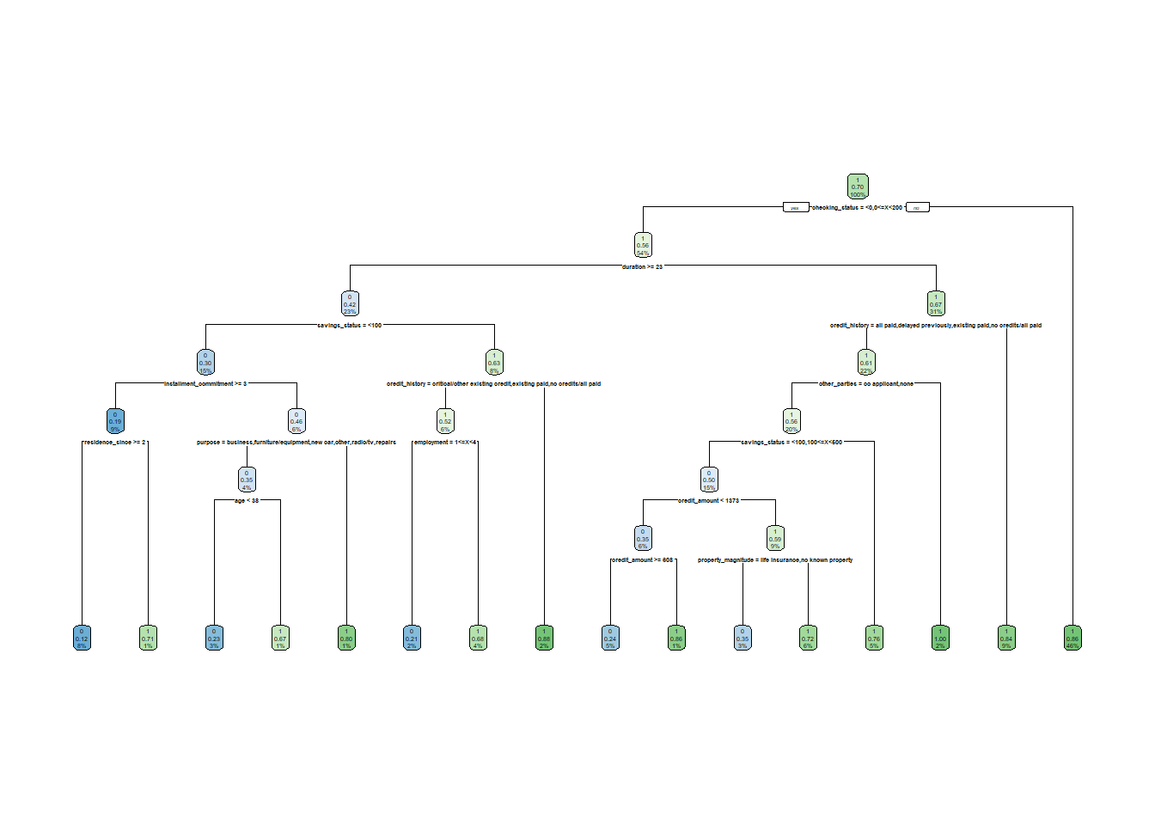
Question 2
Probability Problems
Decision tree
Probability that someone has (purpose=education,job=skilled,num_dependents>1).
0.6%
Probability that someone has (purpose=’used car’ or ’new car’,credit_amount>3000,class=good)
10.2%

Slide 6
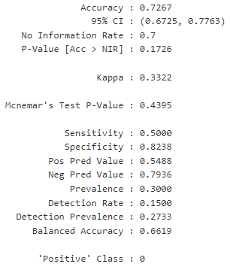
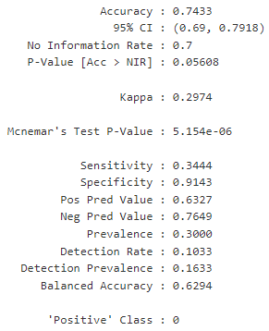
Decision Tree vs. Random Forest
Decision tree
Random forest
Notes:
The most important variable for the decision tree is the checking status which makes sense as this can give great insight into spending habits. Also the duration, savings status and credit amount can also provide insight.
The random forest model produces an accuracy of 74.33% compared to 72.67% with the decision tree proving to be a slighly better model.
When comparing the variable importance of both models, they both signify that the checking status is the most important variable along with duration, credit history, credit amount. I would choose the random forest model over the decision tree.

Slide 7
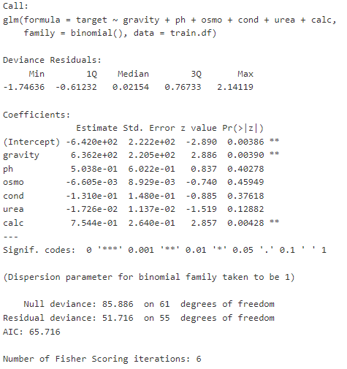
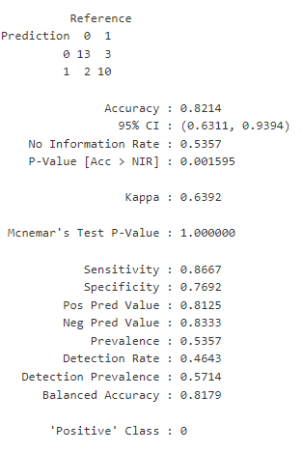
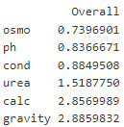
Question 3
Logistic Regression (Full Model)
Notes:
With the y variable being a binary indicator of whether or not the patient has kidney stones. Fitting a logistic model on the training data and using the testing data for predicting landed us an accuracy of 82.14%. Here I have listed the variable importance from least important to most important. I then began omitting the variables making my way down the list in order of importance.

Slide 8
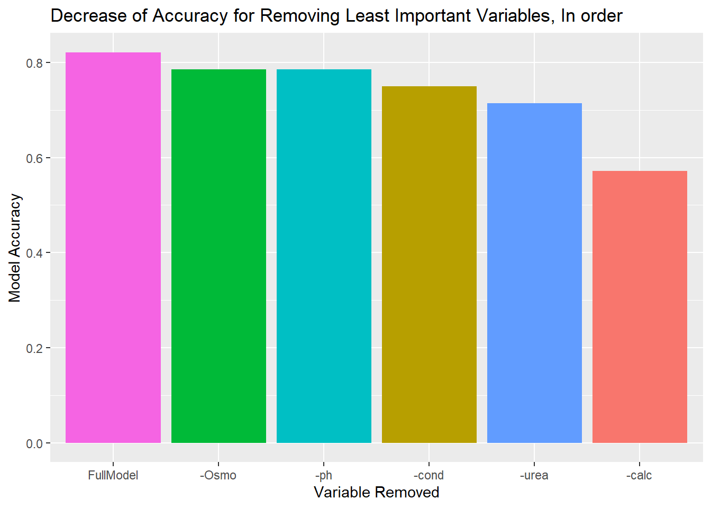
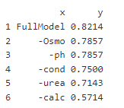
Change in Accuracy
Notes:
We see with osmo removed it drops to .78.57. then osmo and ph, then osmo ph and cond and so on which is illustrated in thebar plot

Slide 9
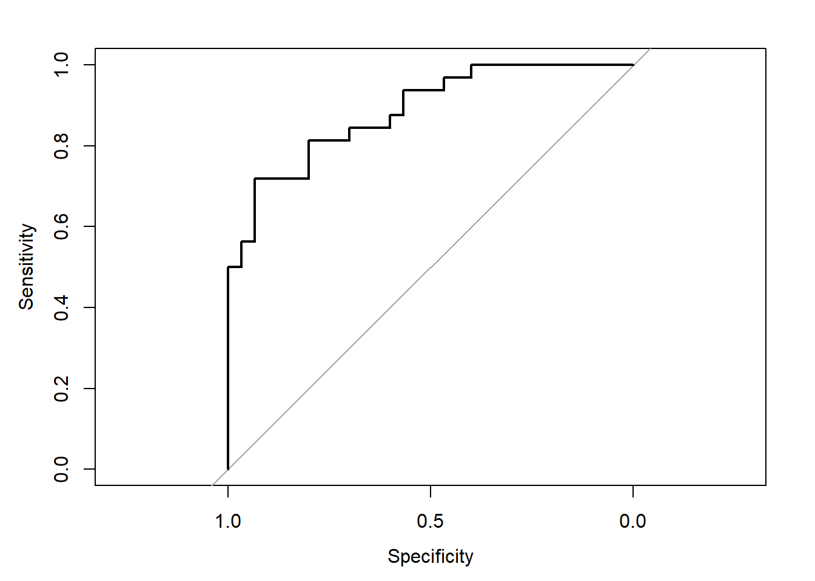
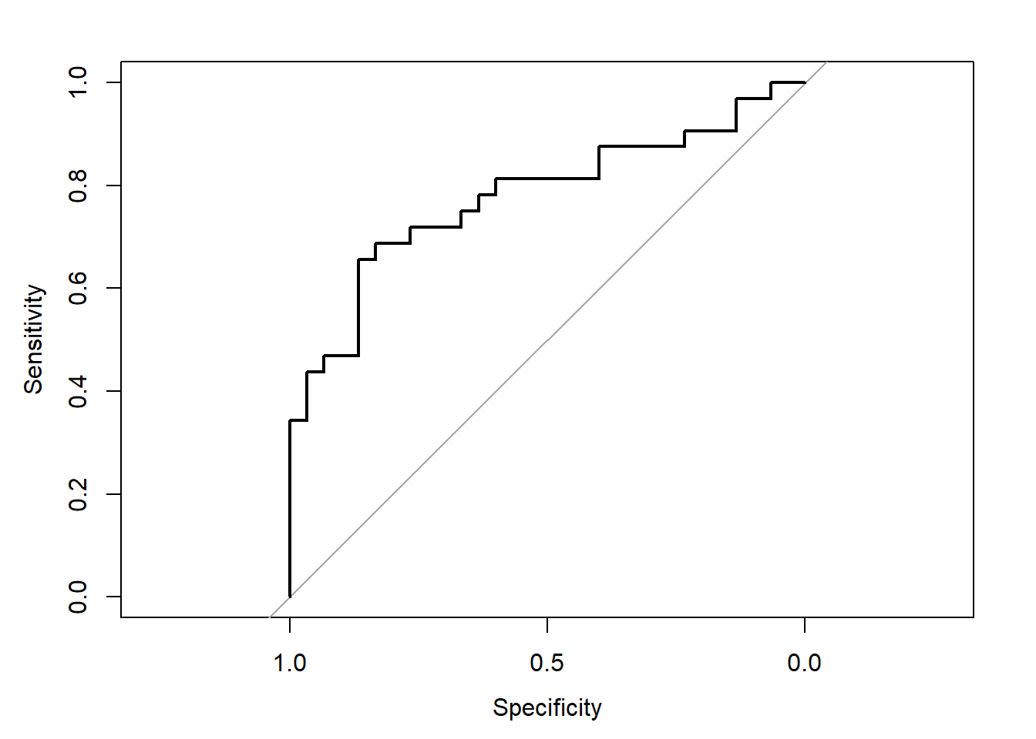
ROC Curves
Full model
Model with most important variable removed
AUC: 0.8844
AUC: 0.7781
Notes:
Removing the most important variable tarnishes the accuracy and the fit of the model. The ROC curve for the full model with all variables present an AUC of .8844 and the model with the most important variable removed retruns a AUC of 0.7781. The best model is the full model with the largest AUC.

Slide 10
QUESTIONS?

